Slide 1
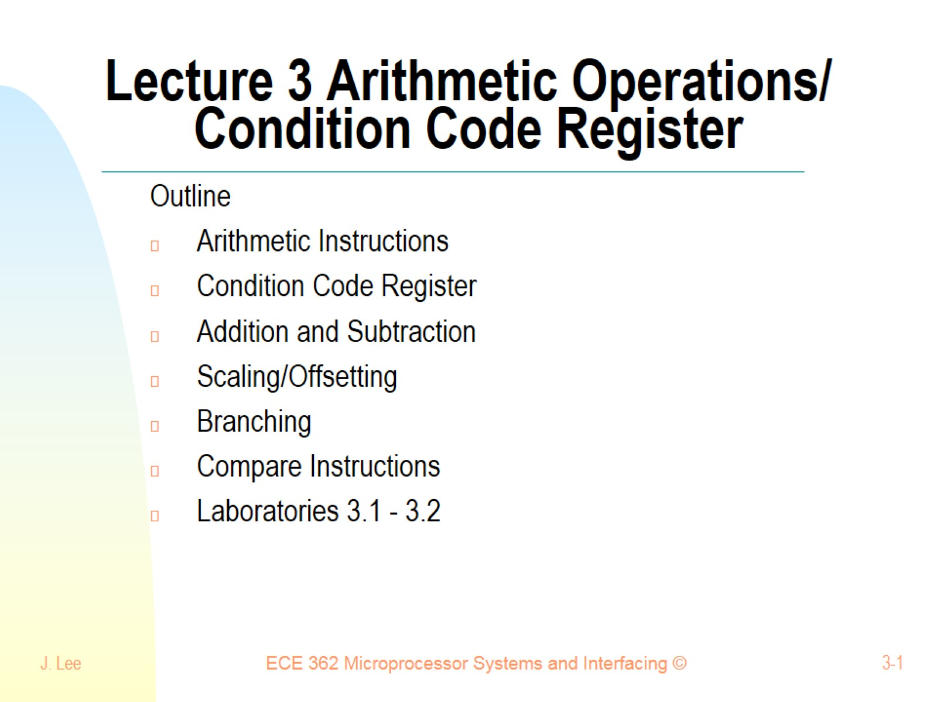
Lecture 3 Arithmetic Operations/ Condition Code Register

Slide 2
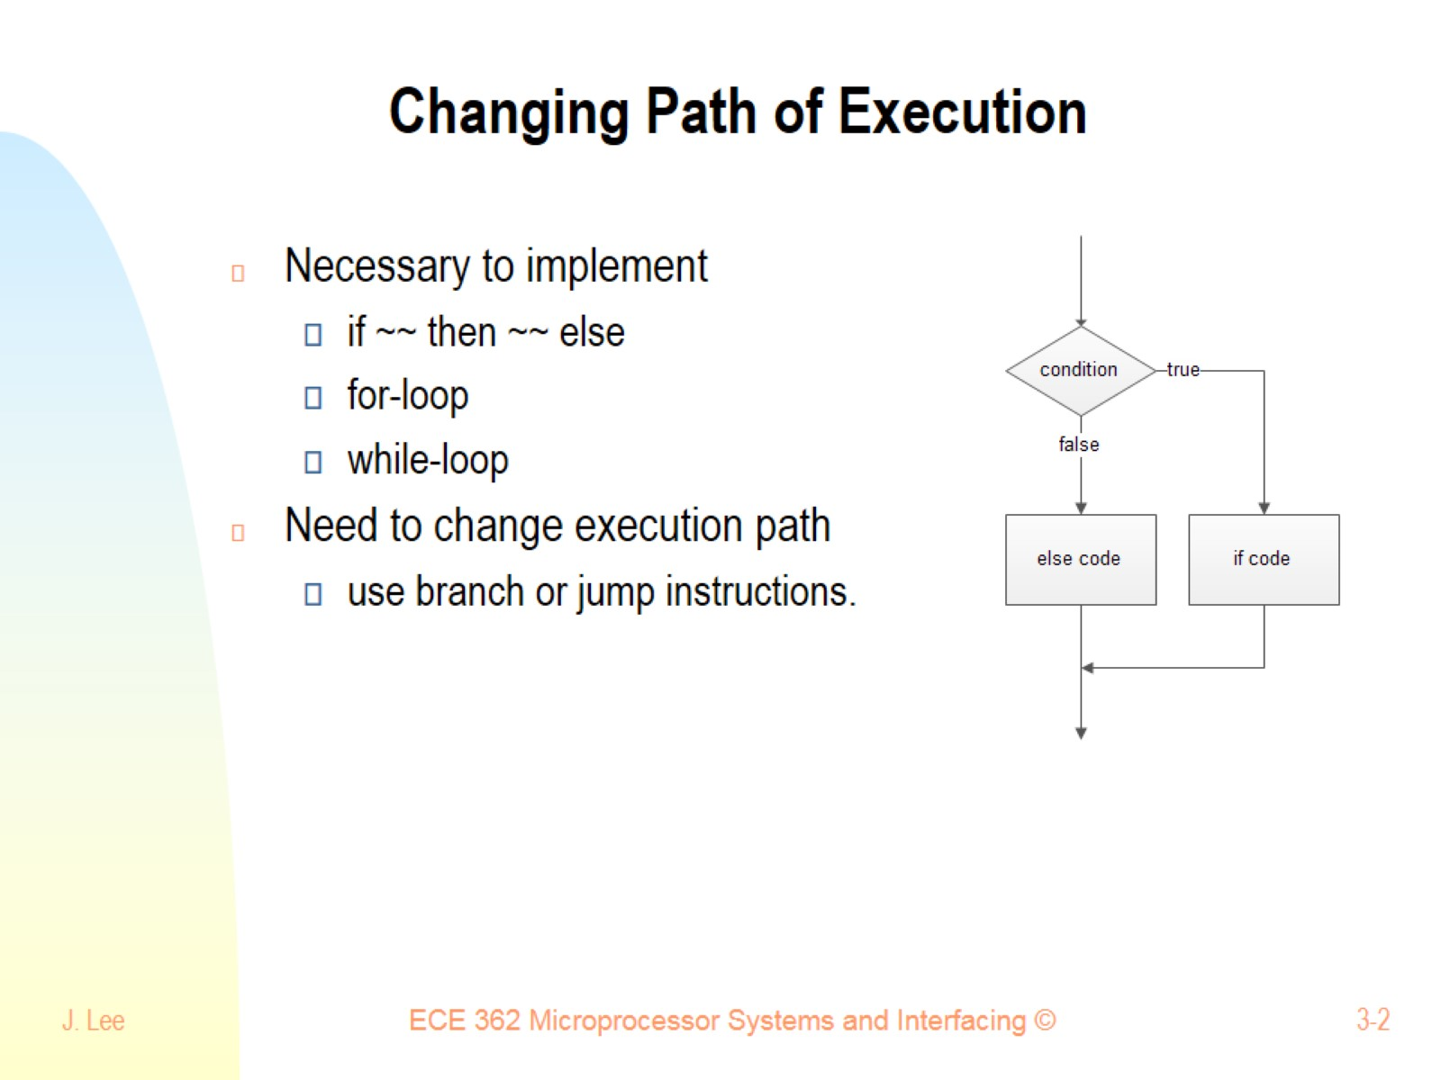
Changing Path of Execution

Slide 3
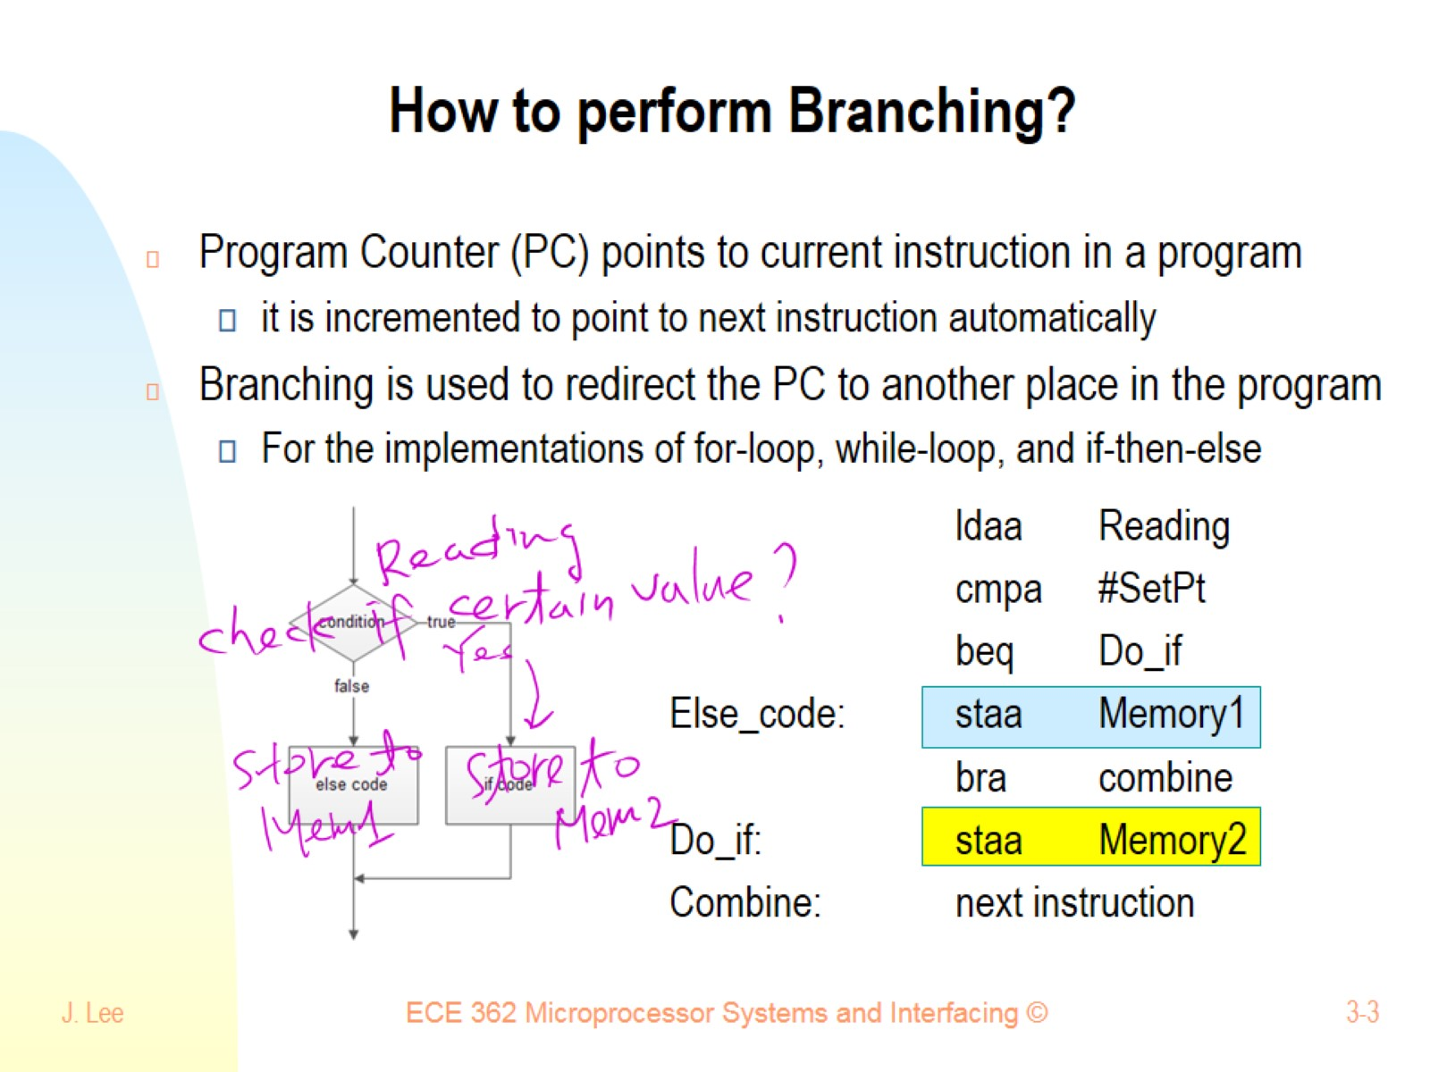
How to perform Branching?

Slide 4
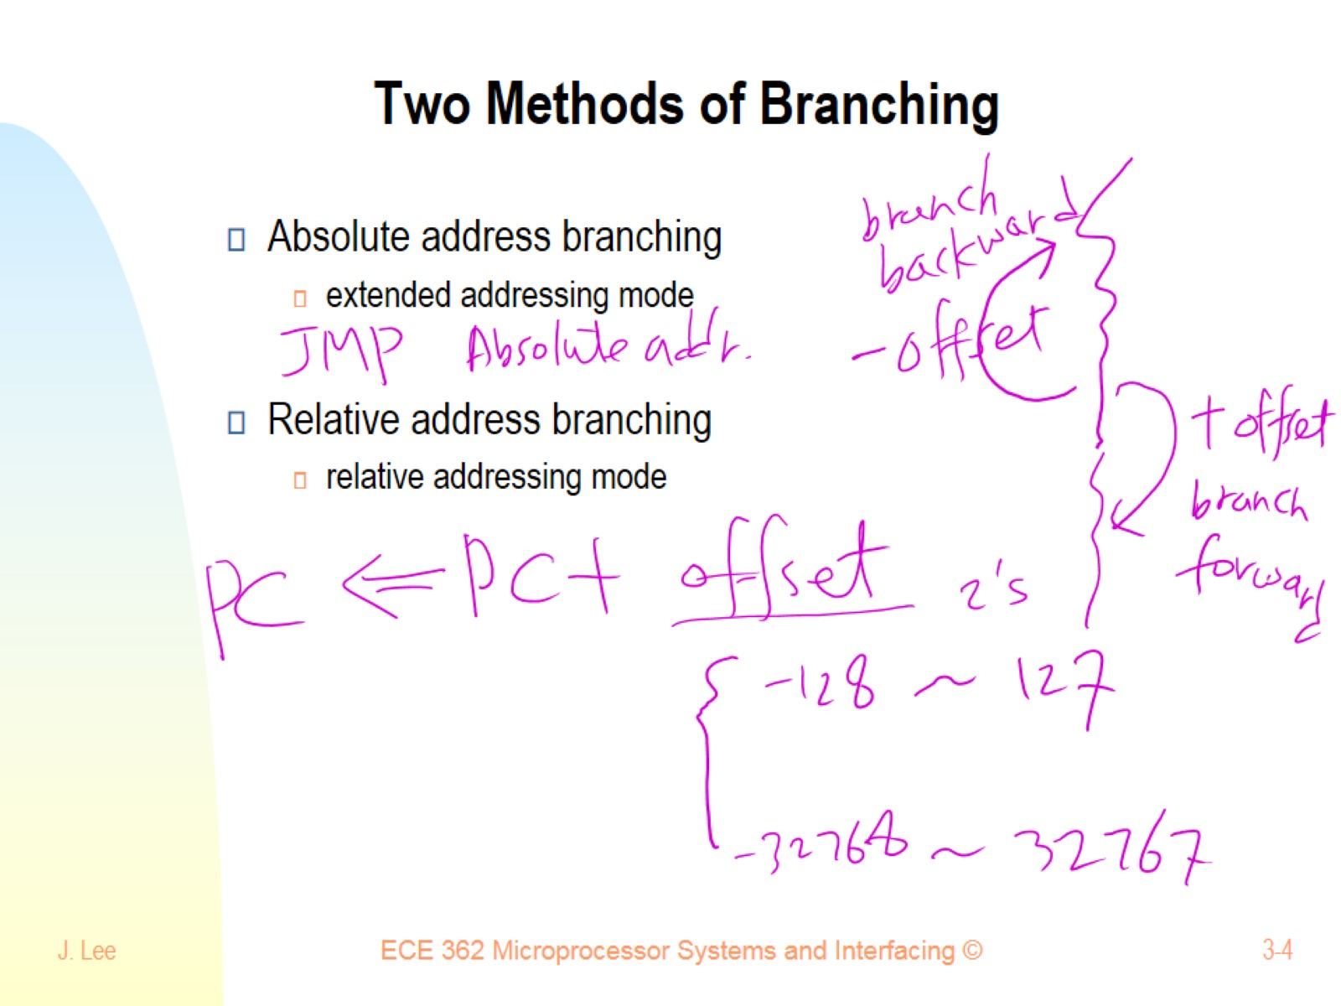
Two Methods of Branching

Slide 5
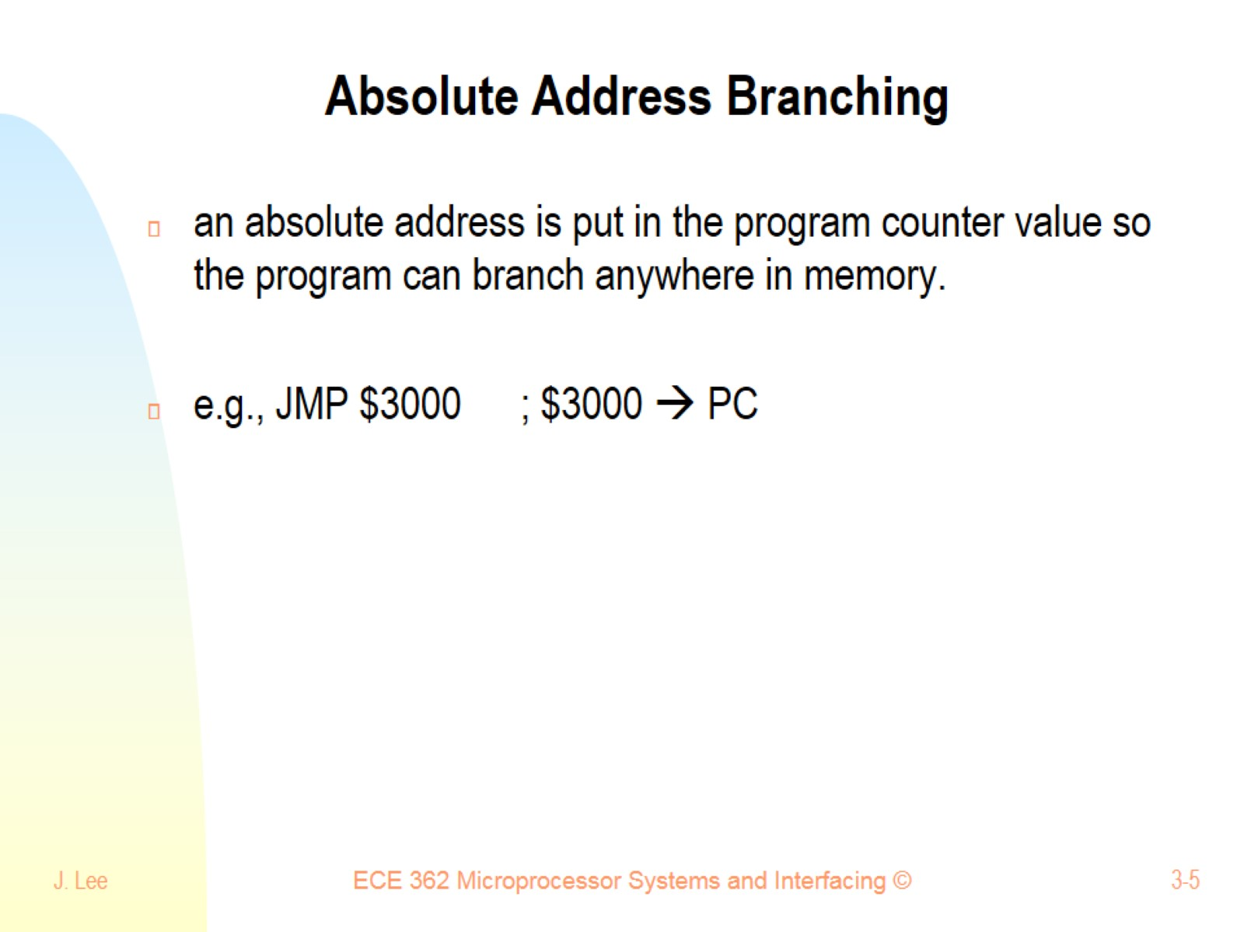
Absolute Address Branching

Slide 6
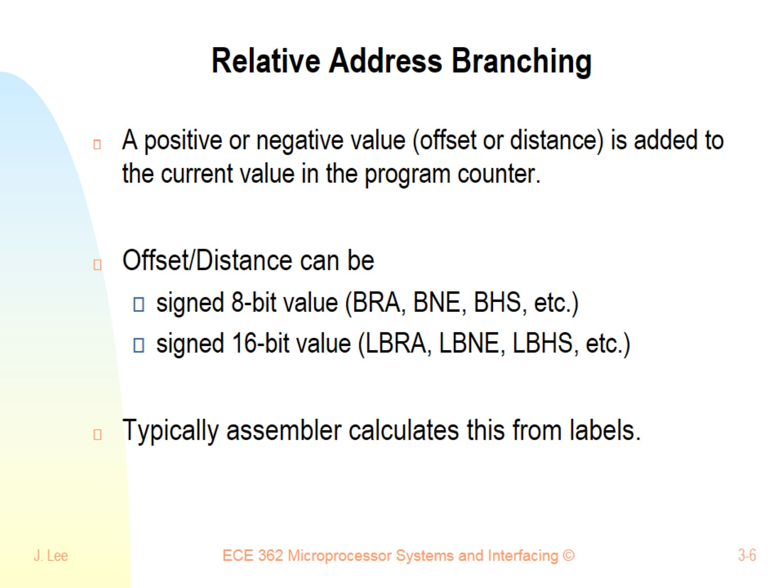
Relative Address Branching

Slide 7
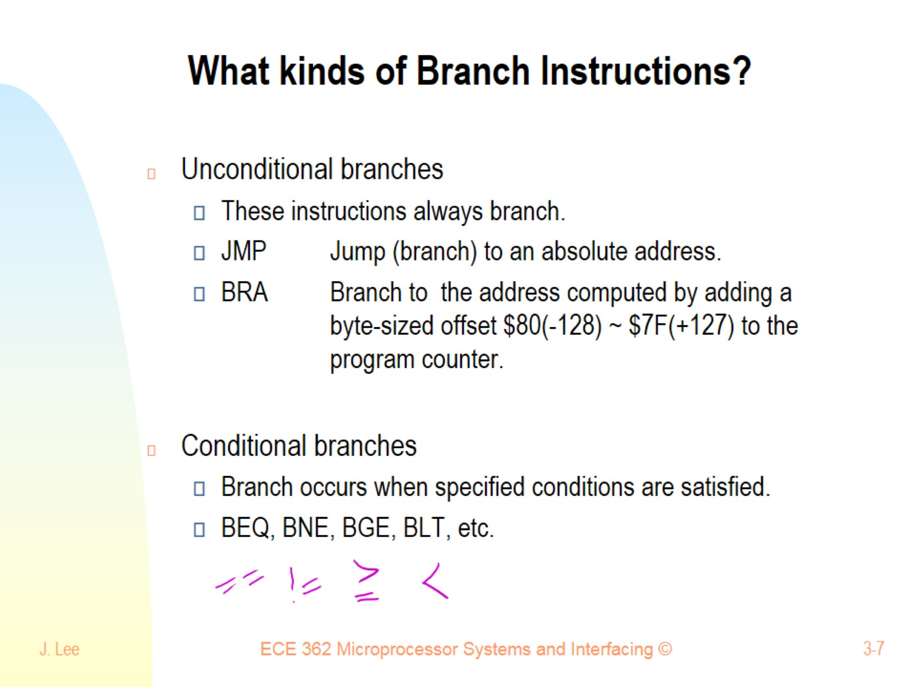
What kinds of Branch Instructions?

Slide 8
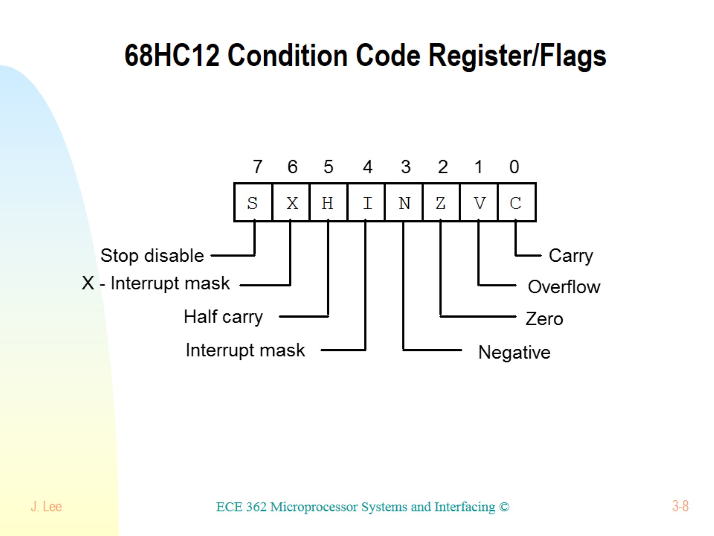
68HC12 Condition Code Register/Flags

Slide 9
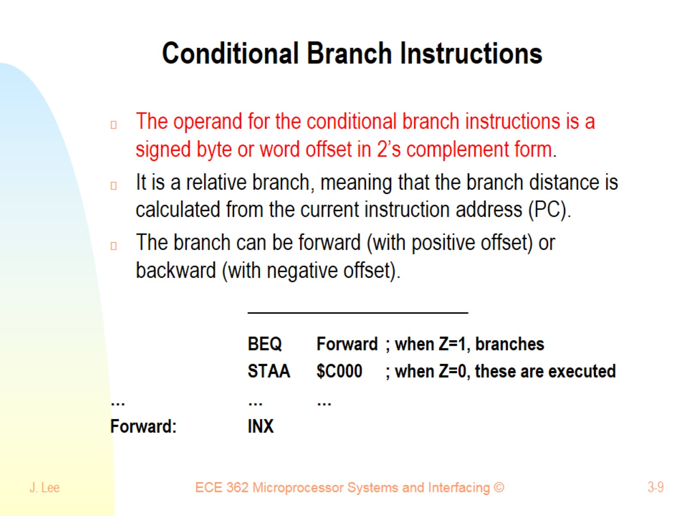
Conditional Branch Instructions

Slide 10
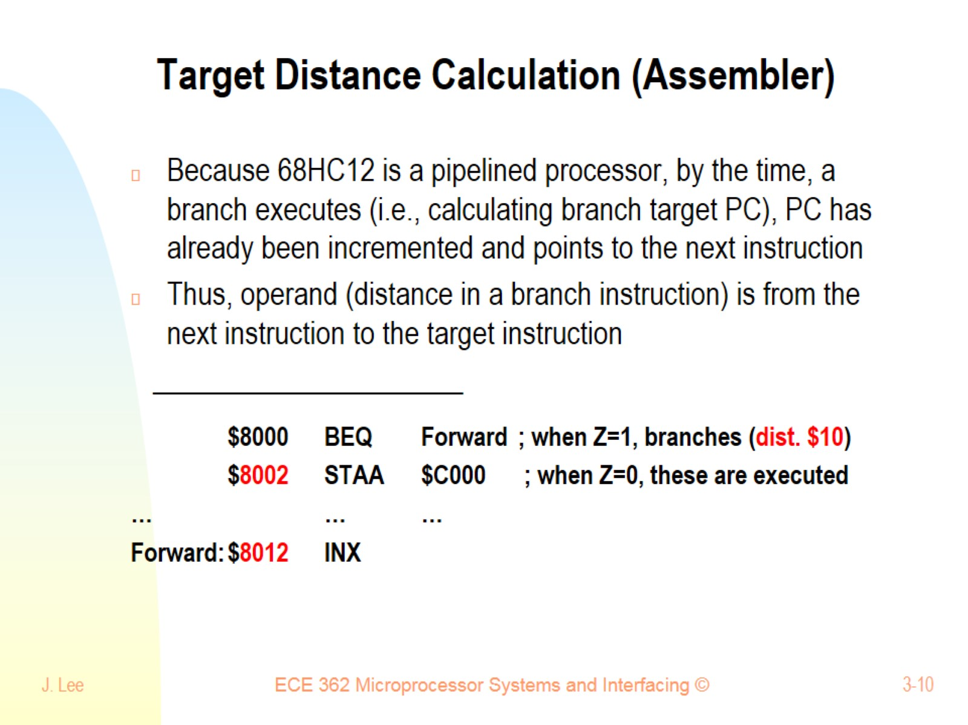
Target Distance Calculation (Assembler)

Slide 11
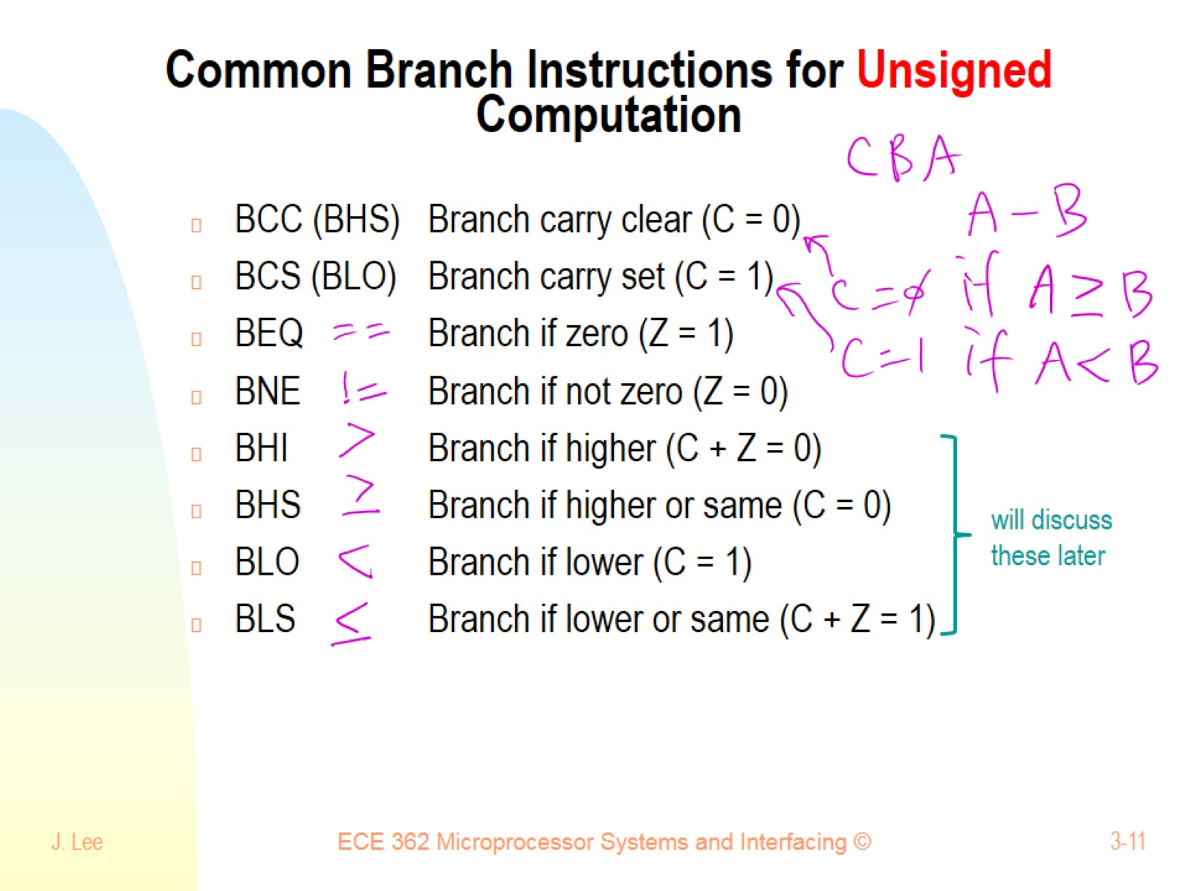
Common Branch Instructions for Unsigned Computation

Slide 12
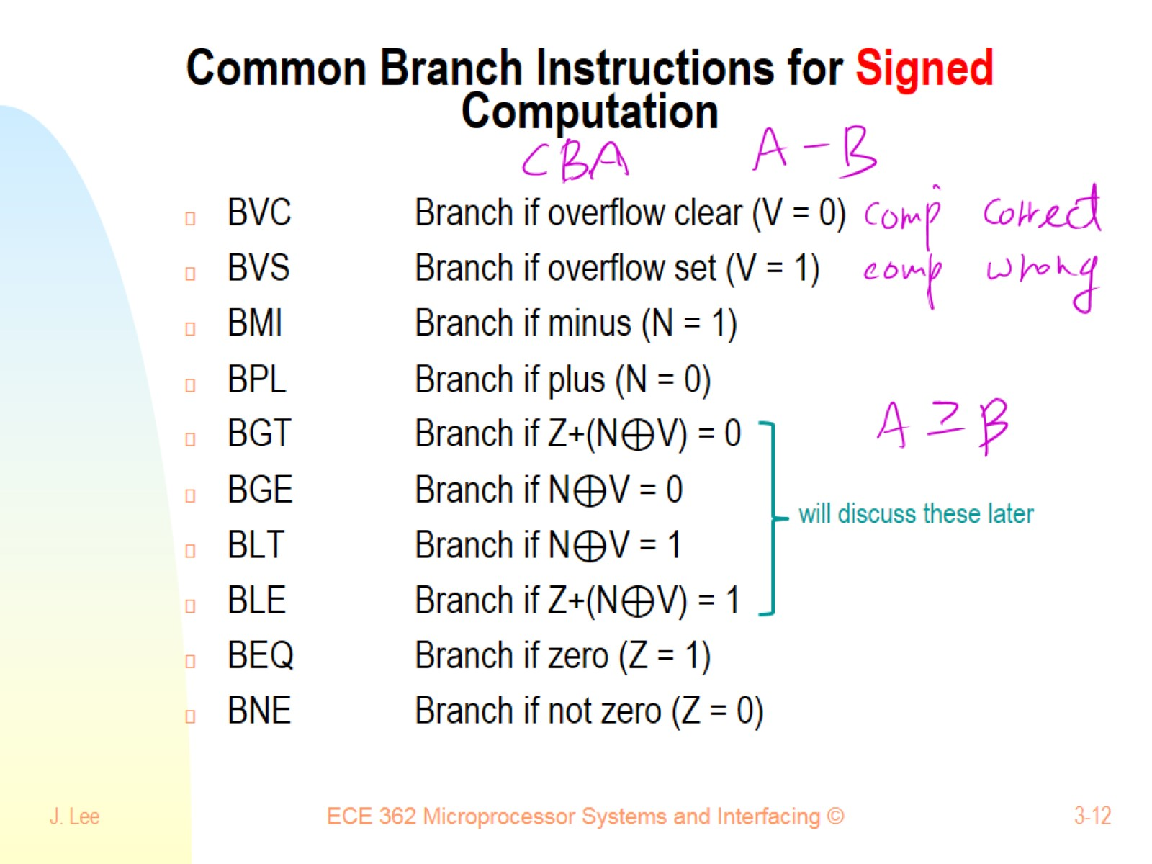
Common Branch Instructions for Signed Computation

Slide 13
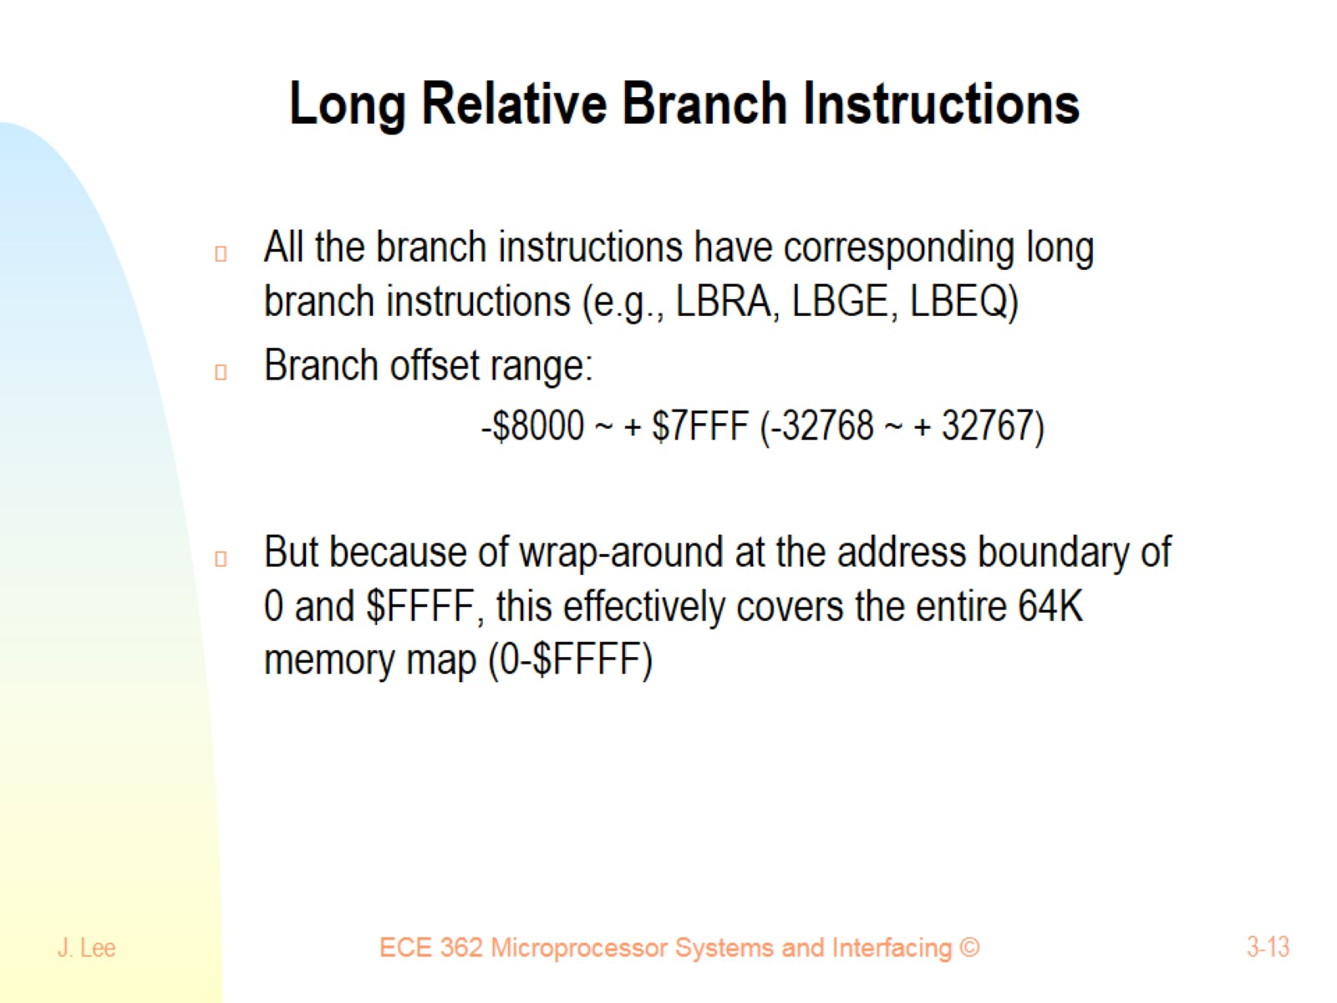
Long Relative Branch Instructions

Slide 14
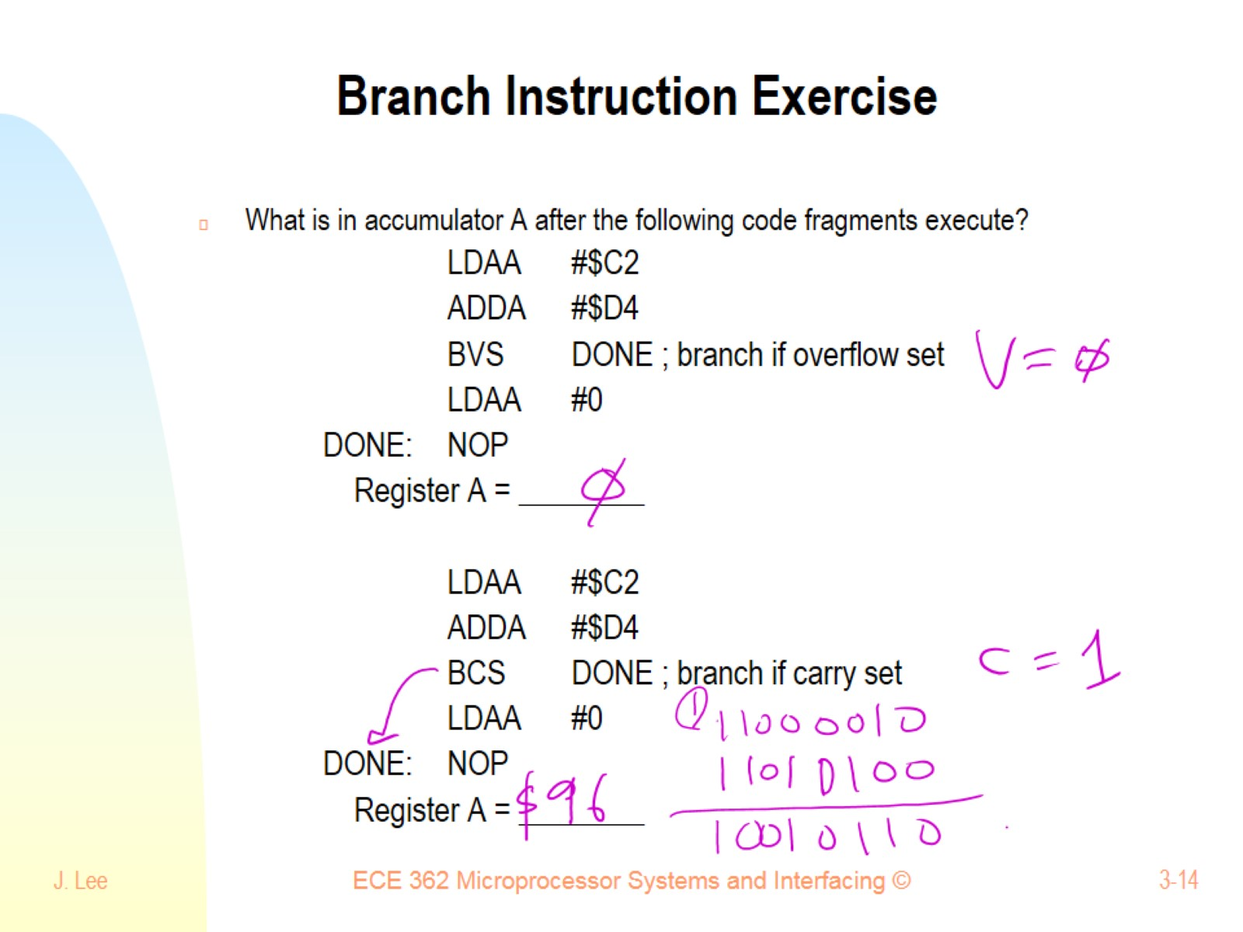
Branch Instruction Exercise

Slide 15
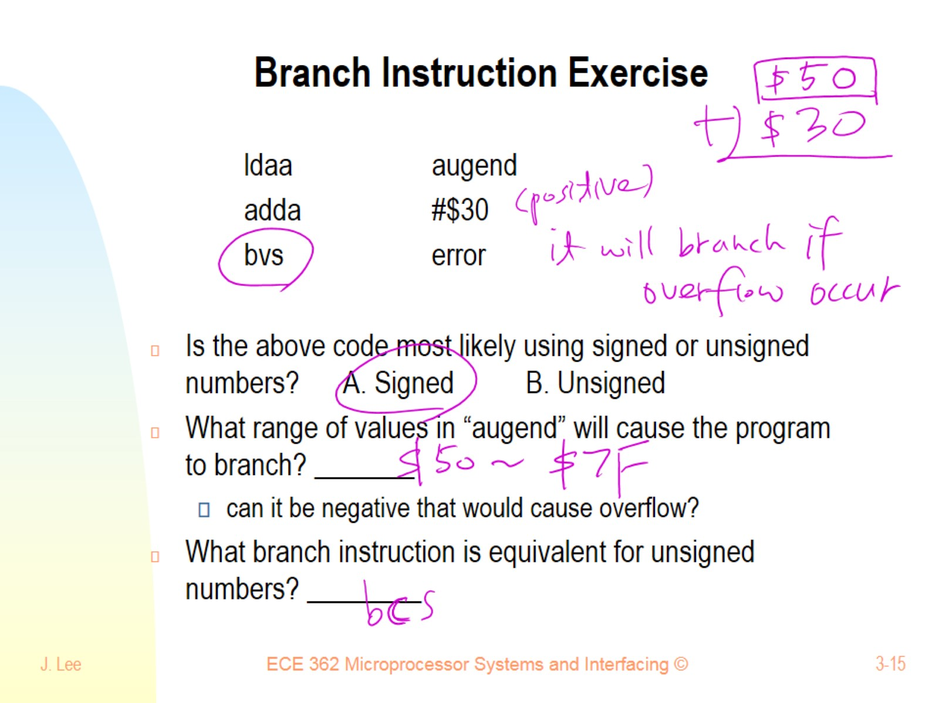
Branch Instruction Exercise

Slide 16
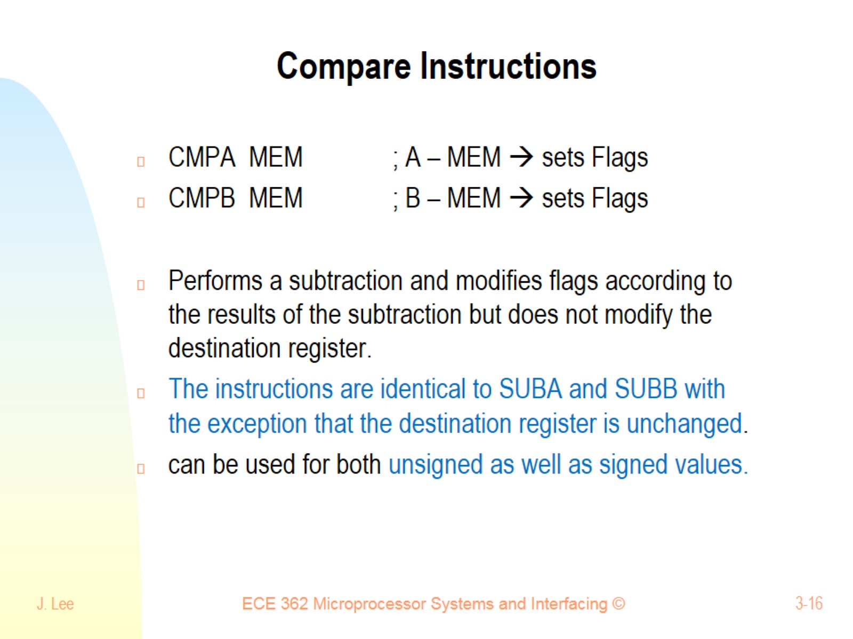
Compare Instructions

Slide 17
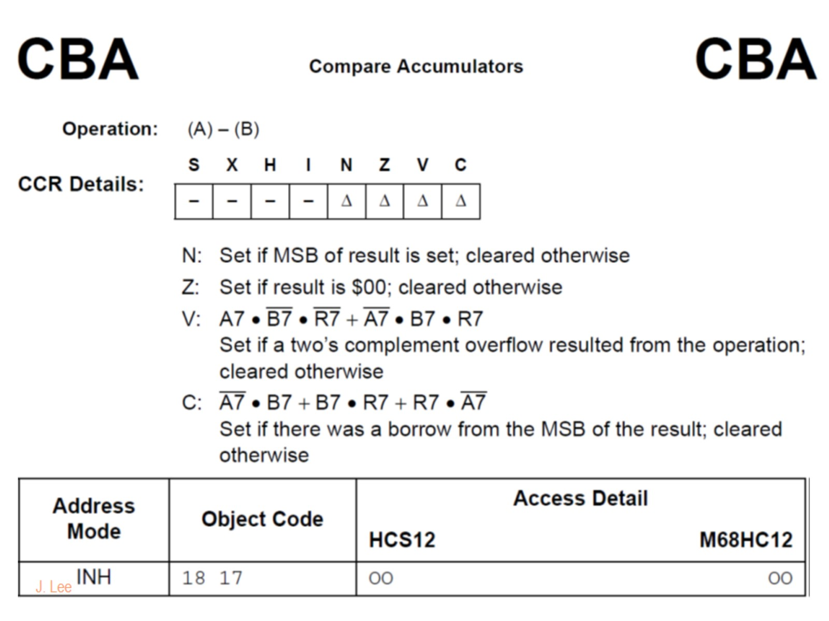

Slide 18
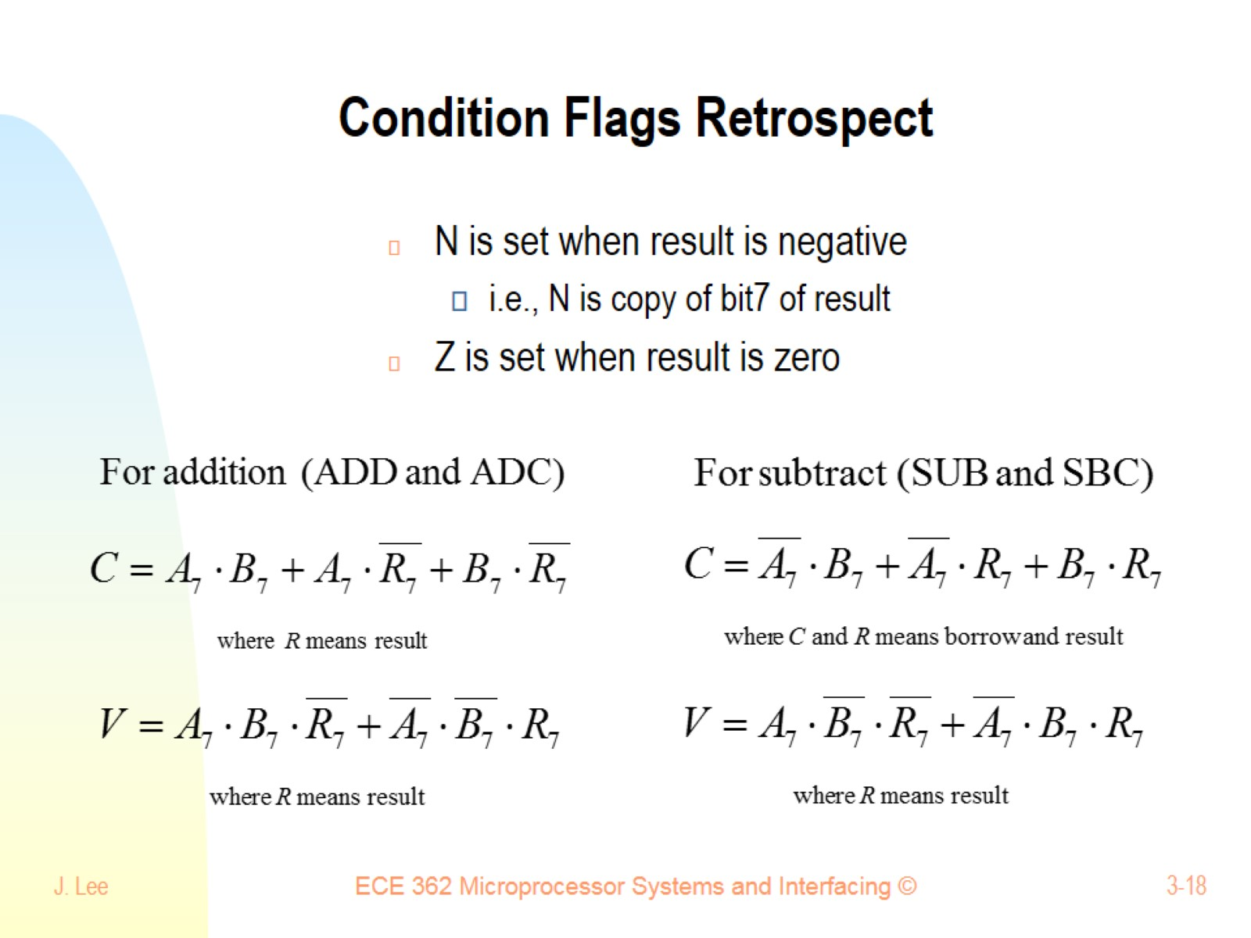
Condition Flags Retrospect

Slide 19
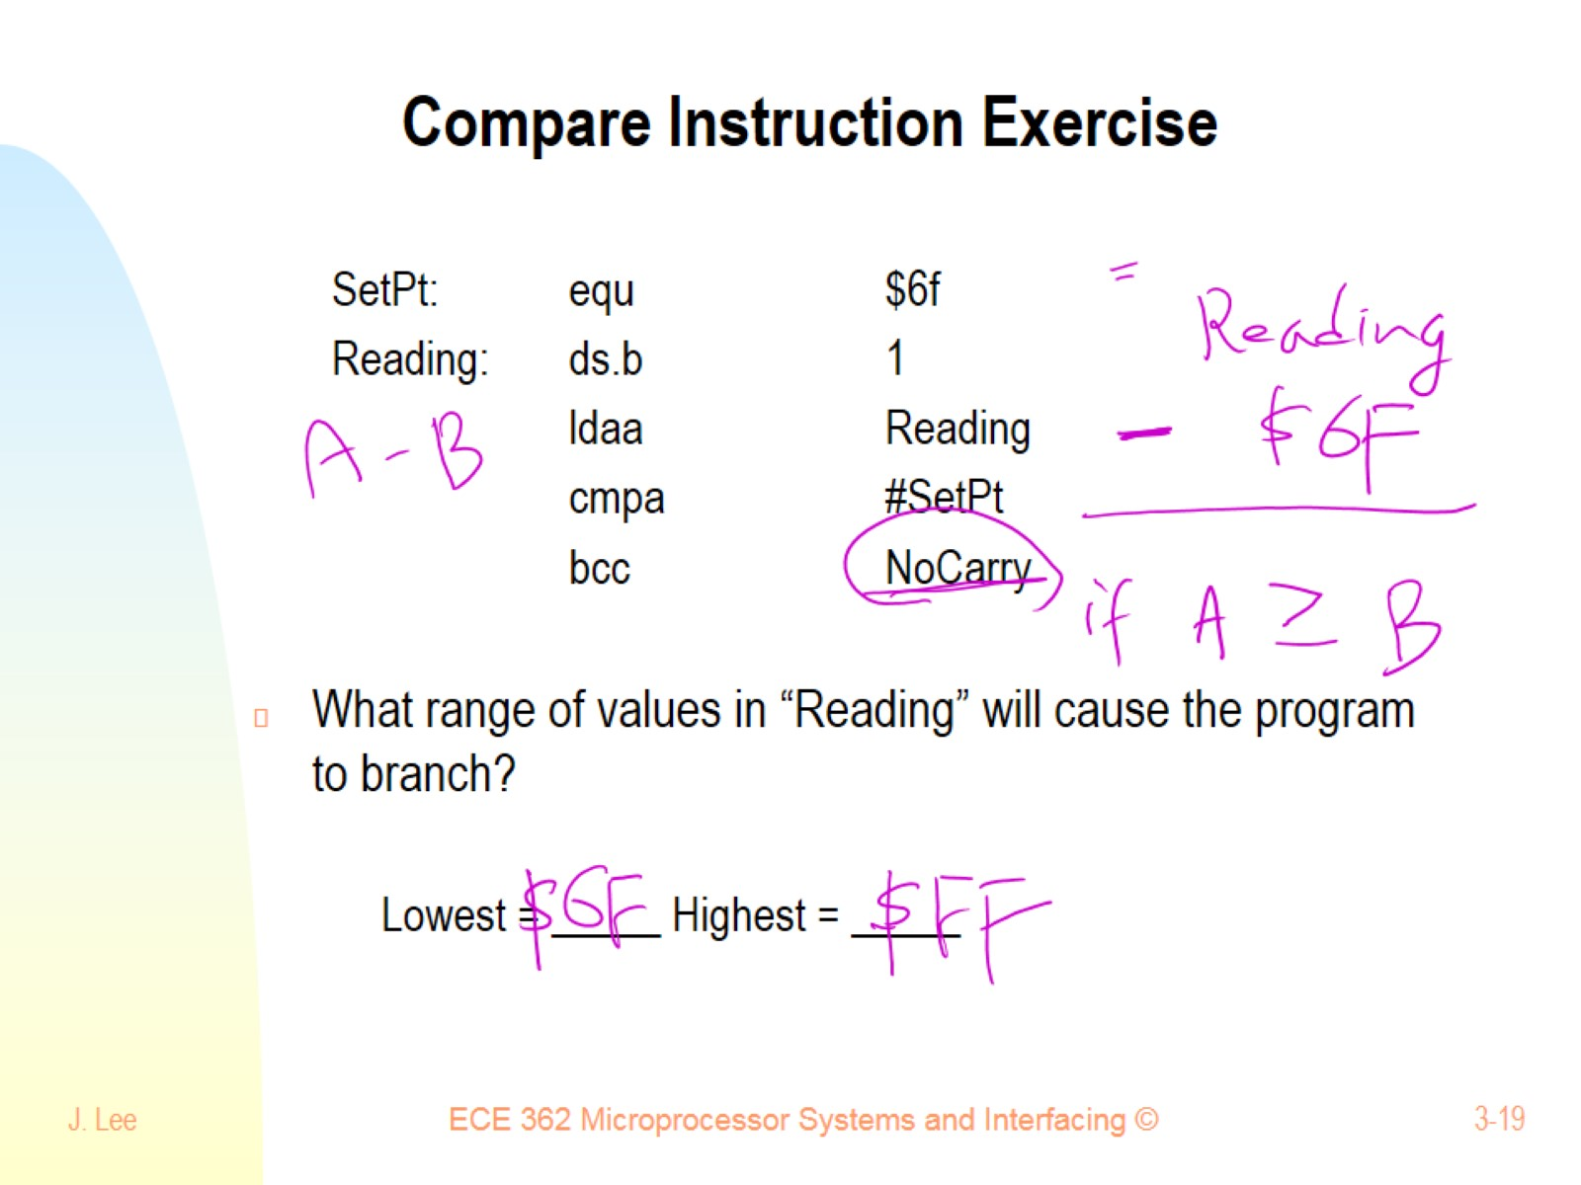
Compare Instruction Exercise

Slide 20
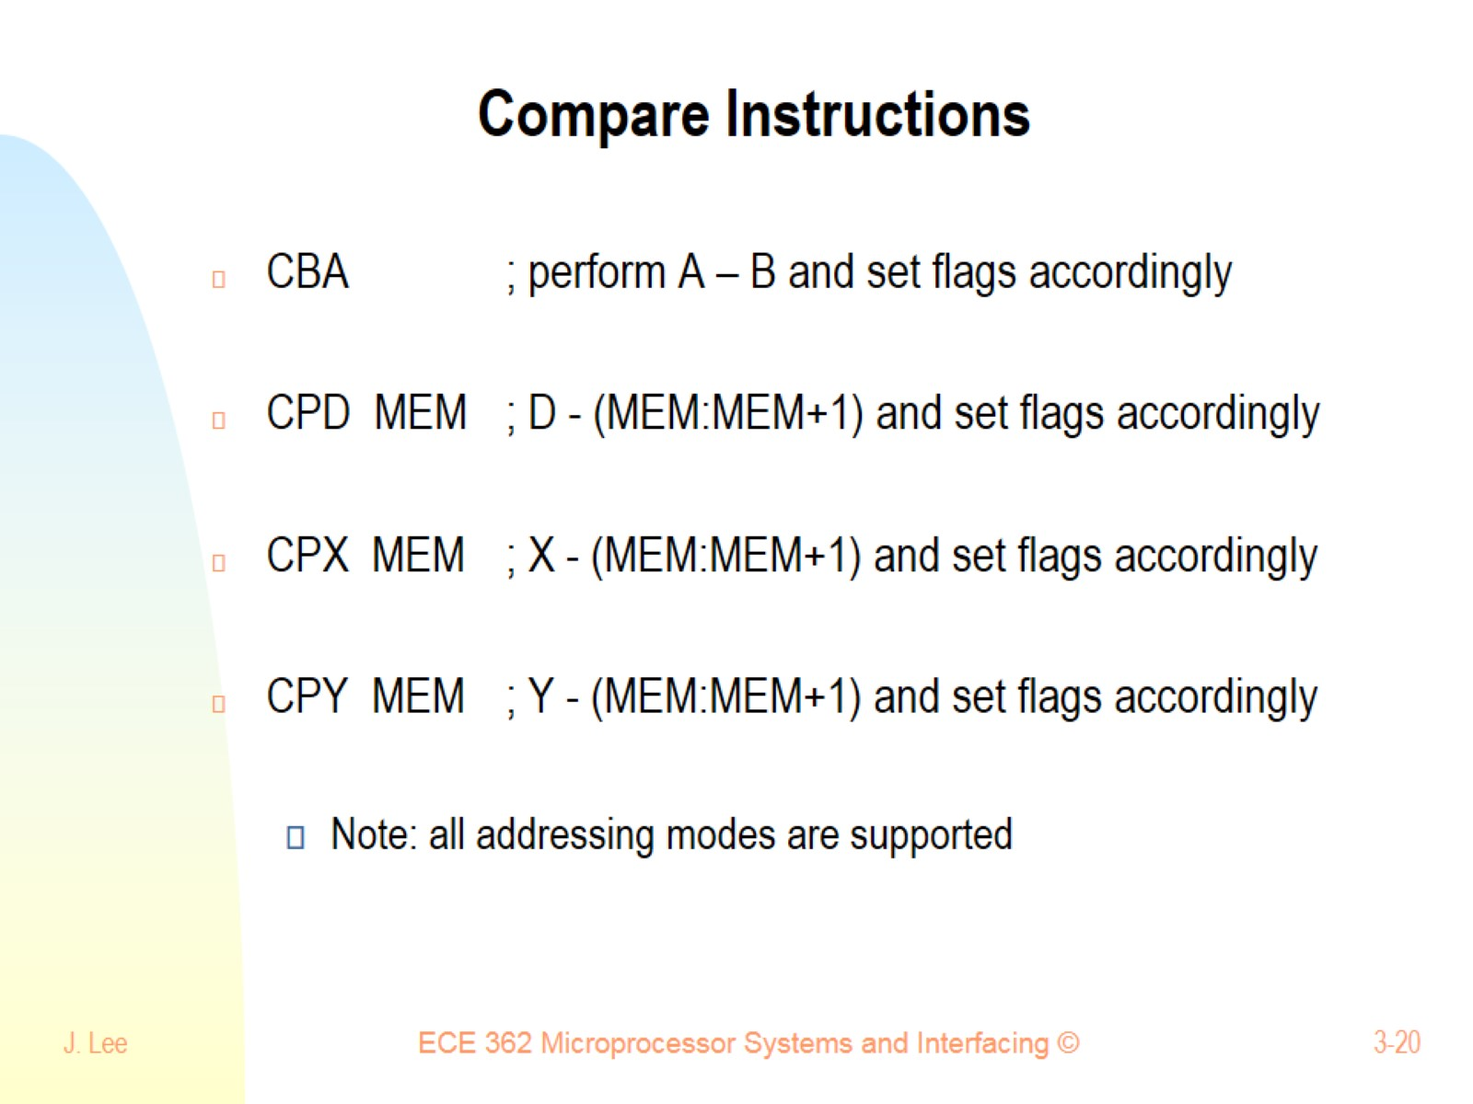
Compare Instructions

Slide 21
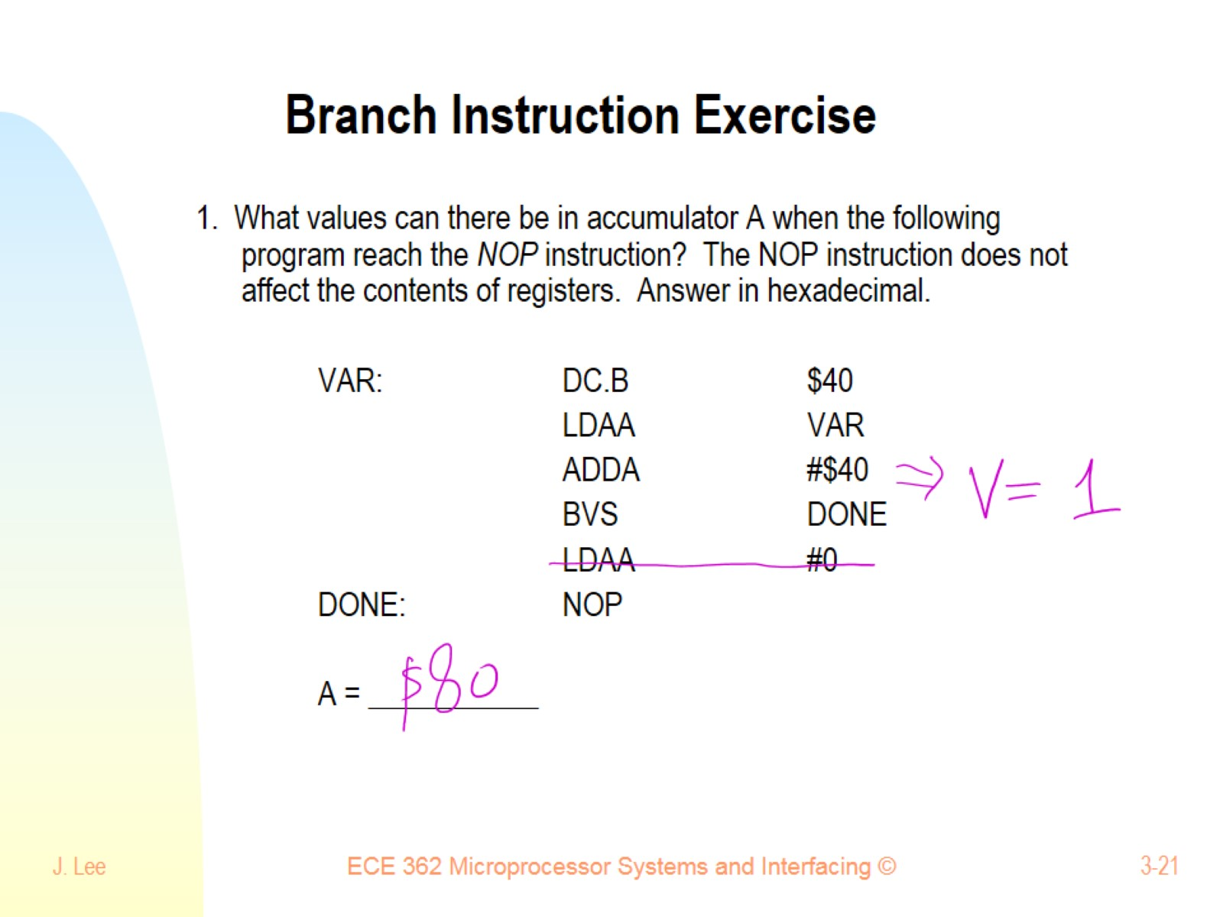
Branch Instruction Exercise

Slide 22
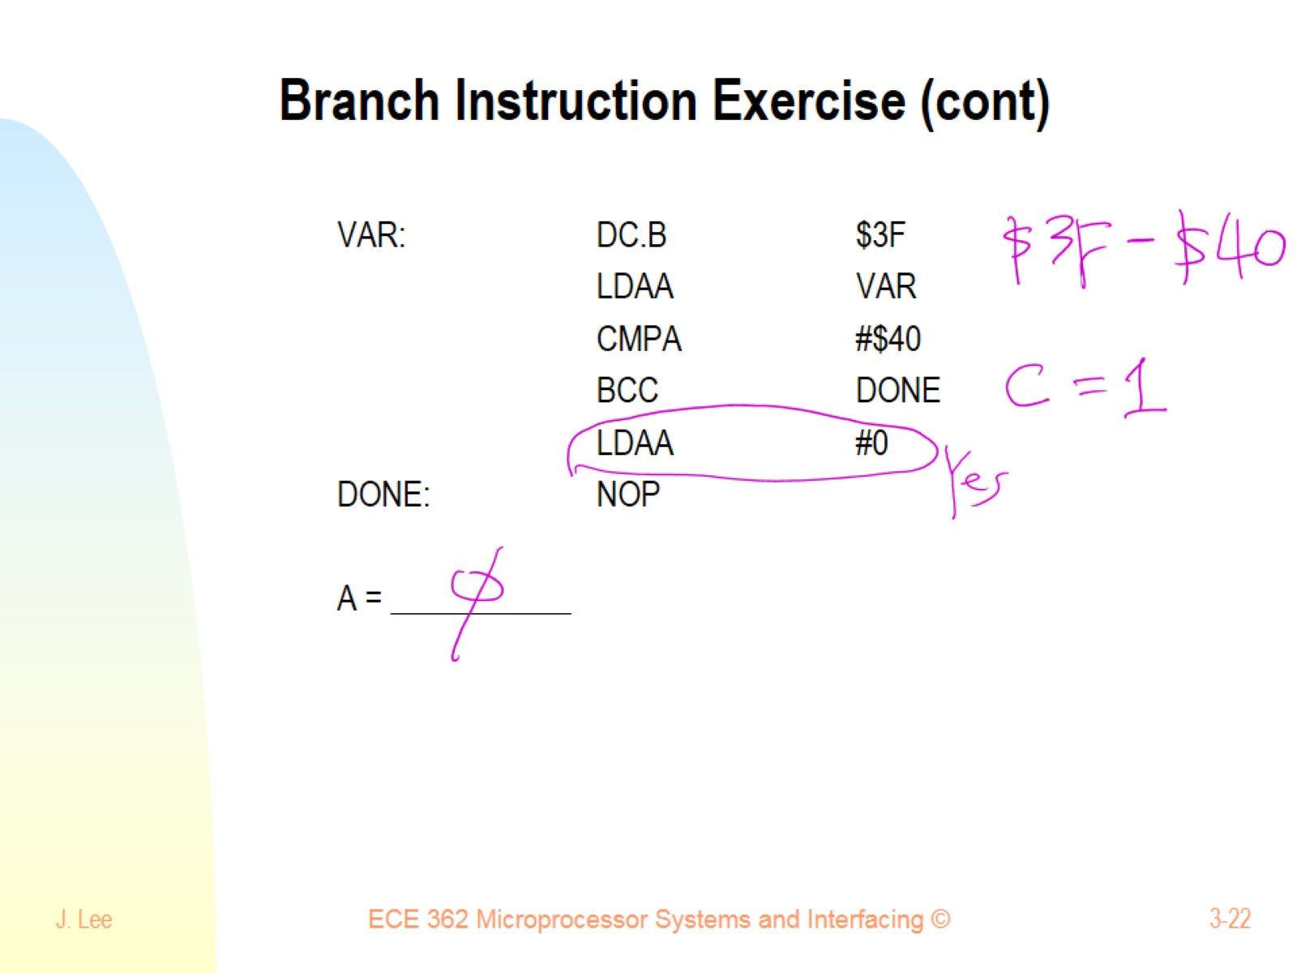
Branch Instruction Exercise (cont)

Slide 23
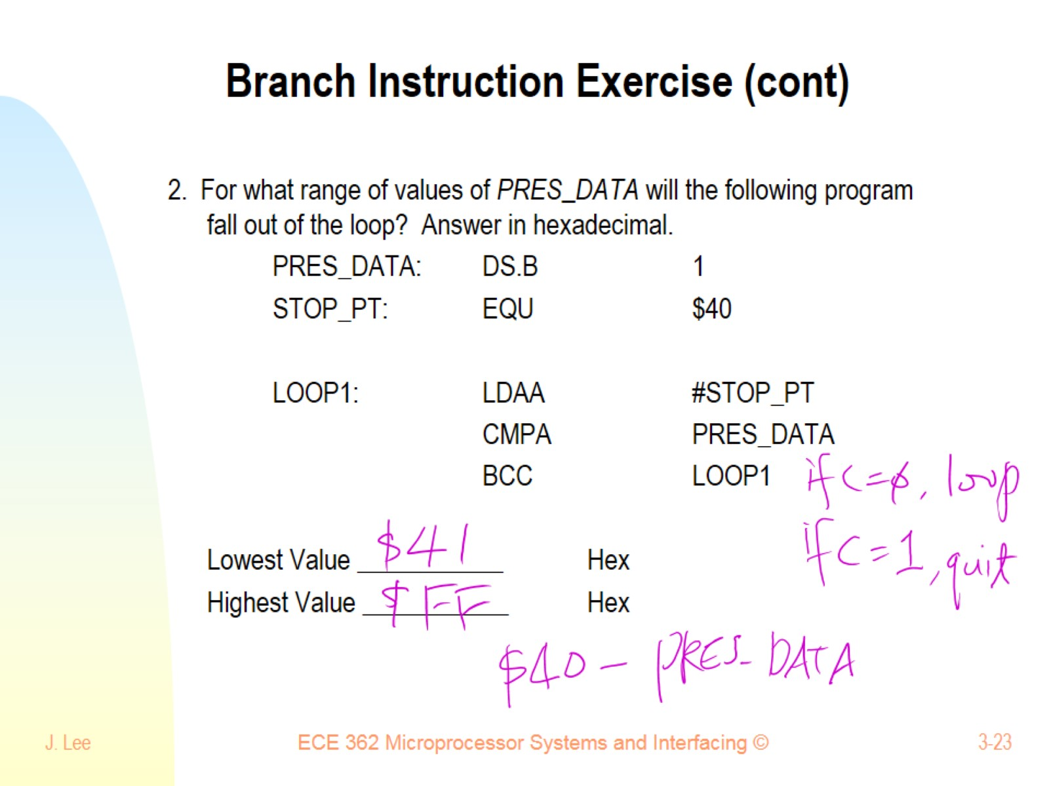
Branch Instruction Exercise (cont)

Slide 24
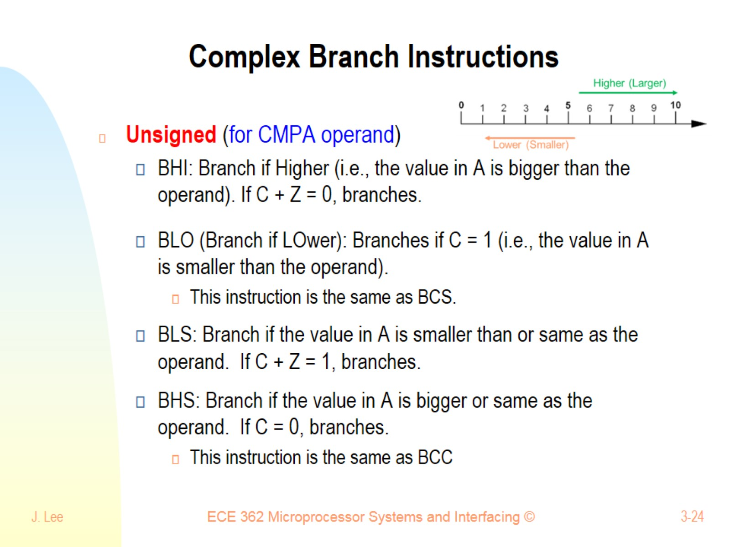
Complex Branch Instructions

Slide 25
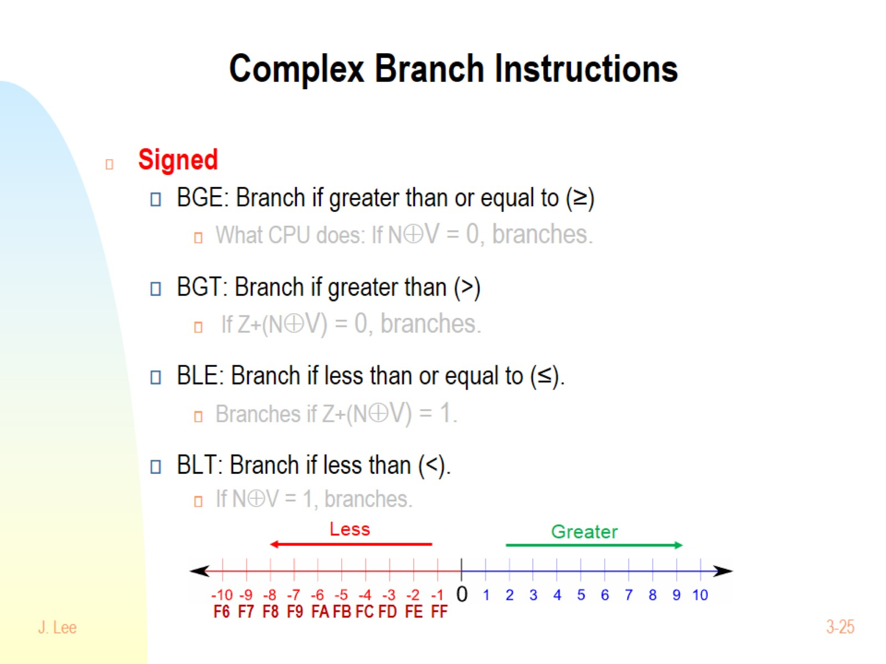
Complex Branch Instructions

Slide 26
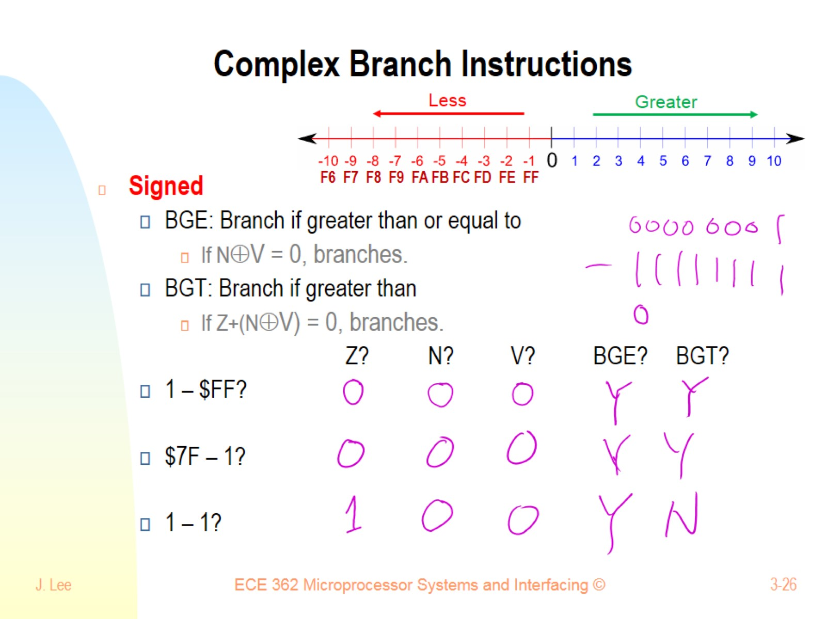
Complex Branch Instructions

Slide 27
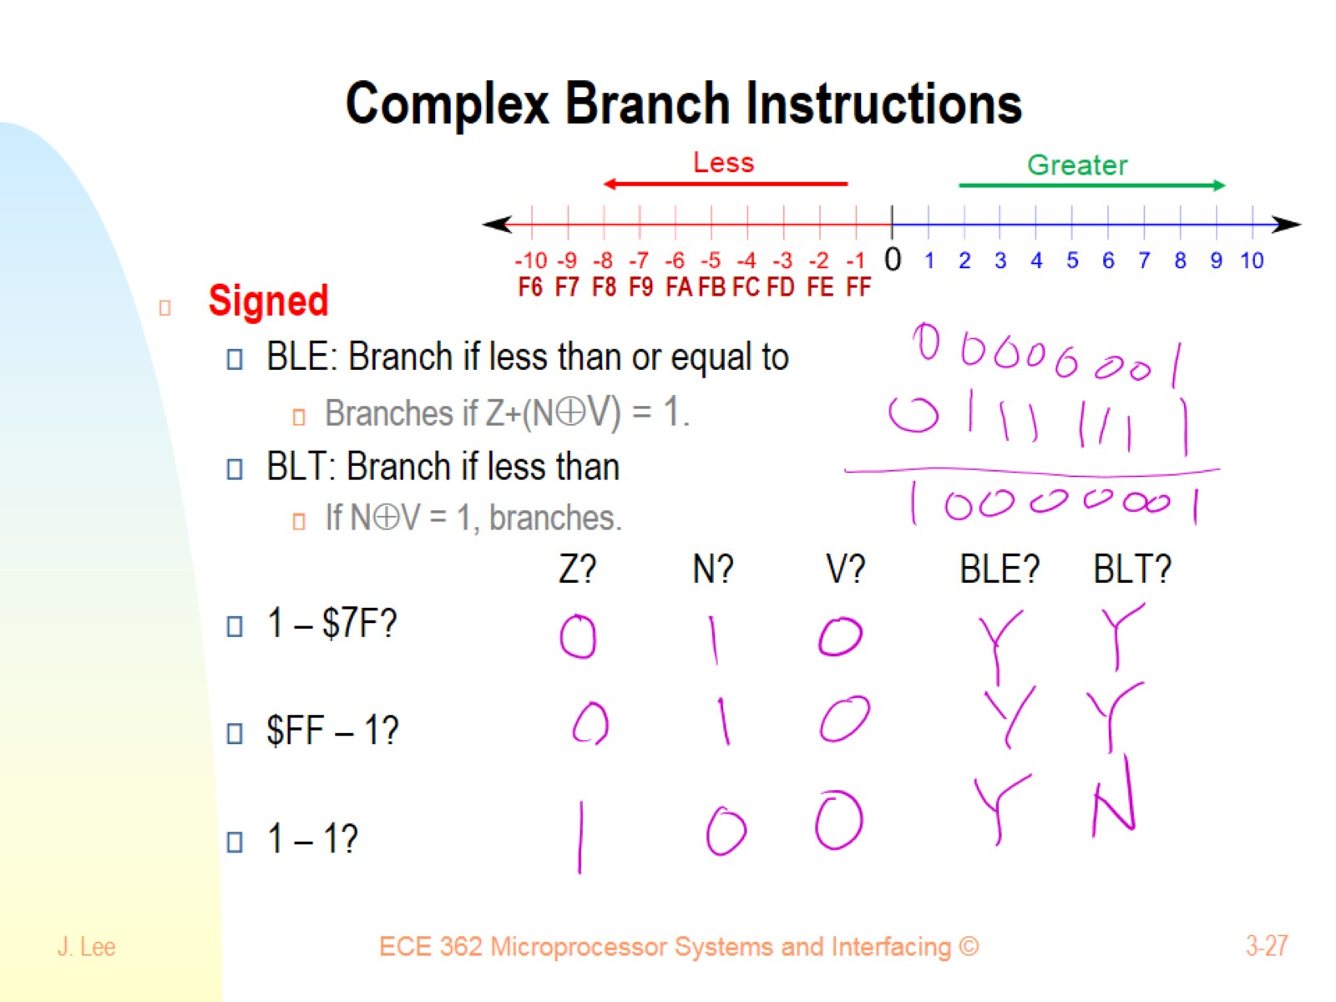
Complex Branch Instructions

Slide 28
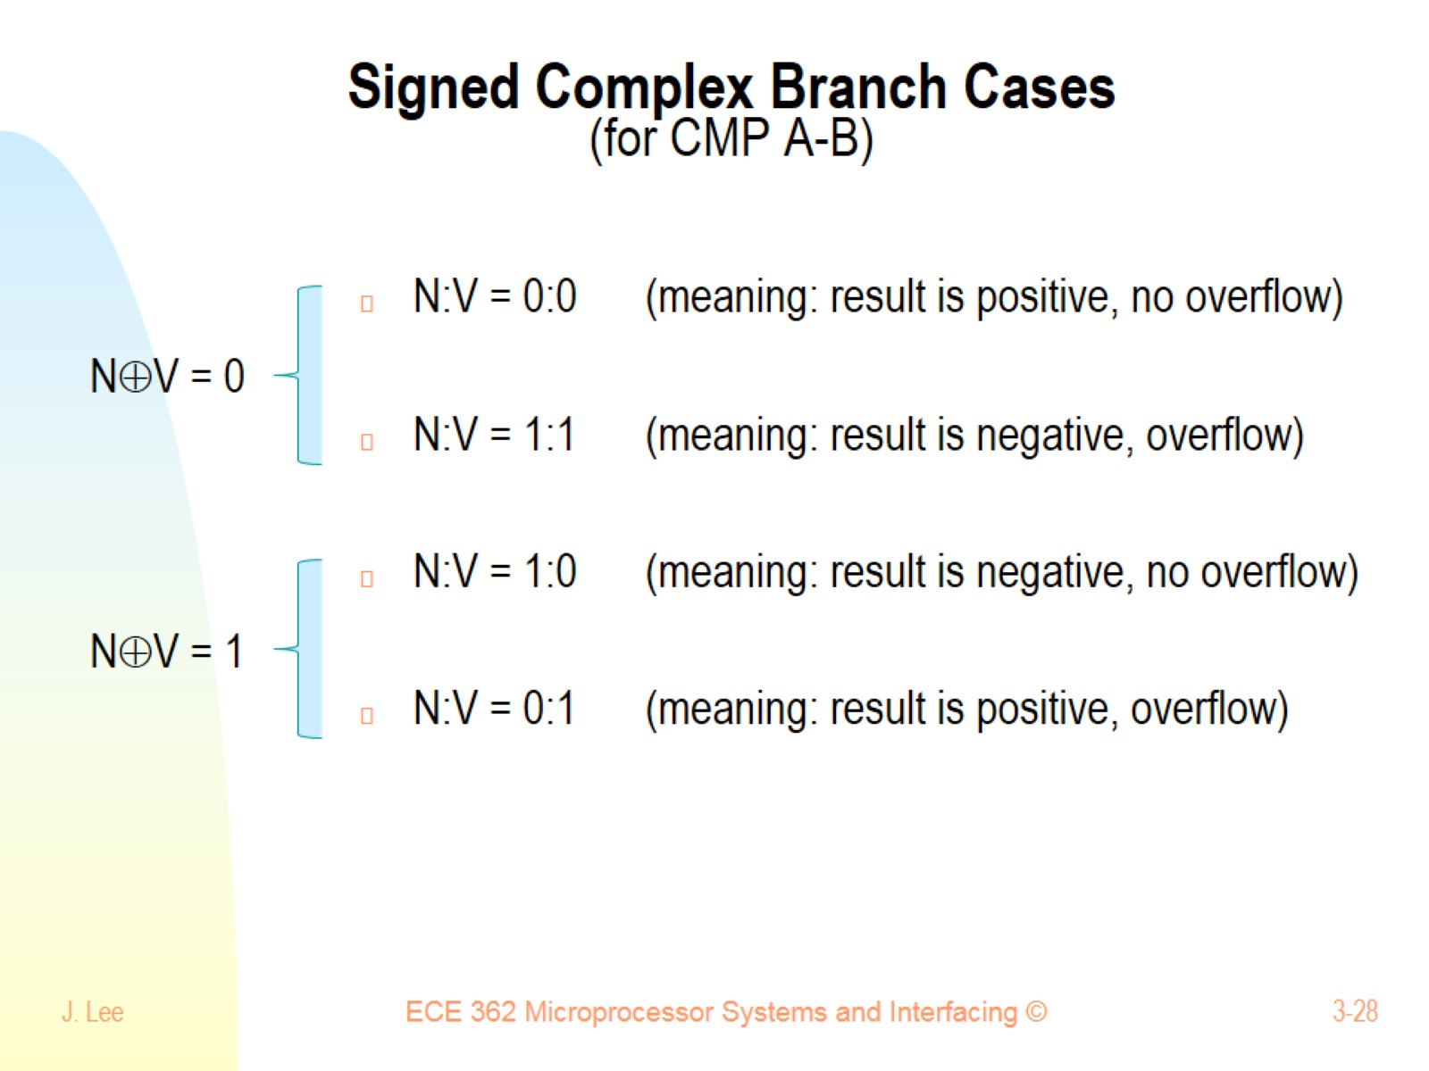
Signed Complex Branch Cases (for CMP A-B)

Slide 29
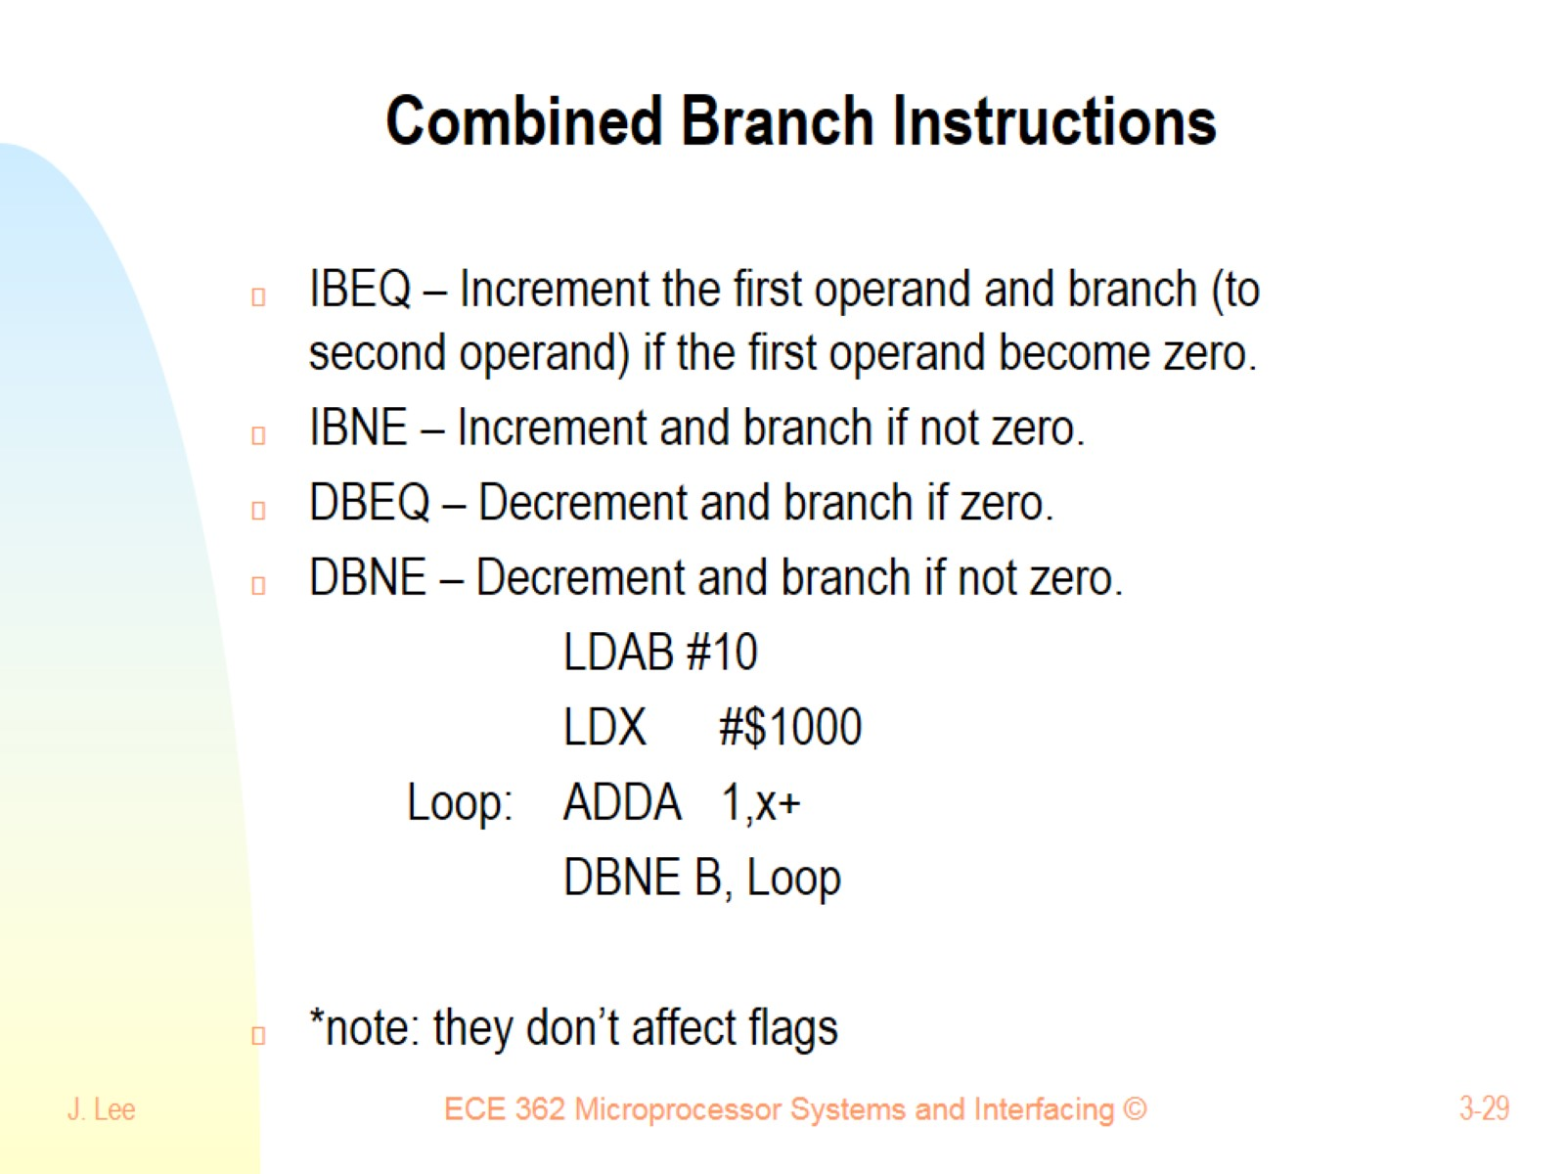
Combined Branch Instructions

Slide 30
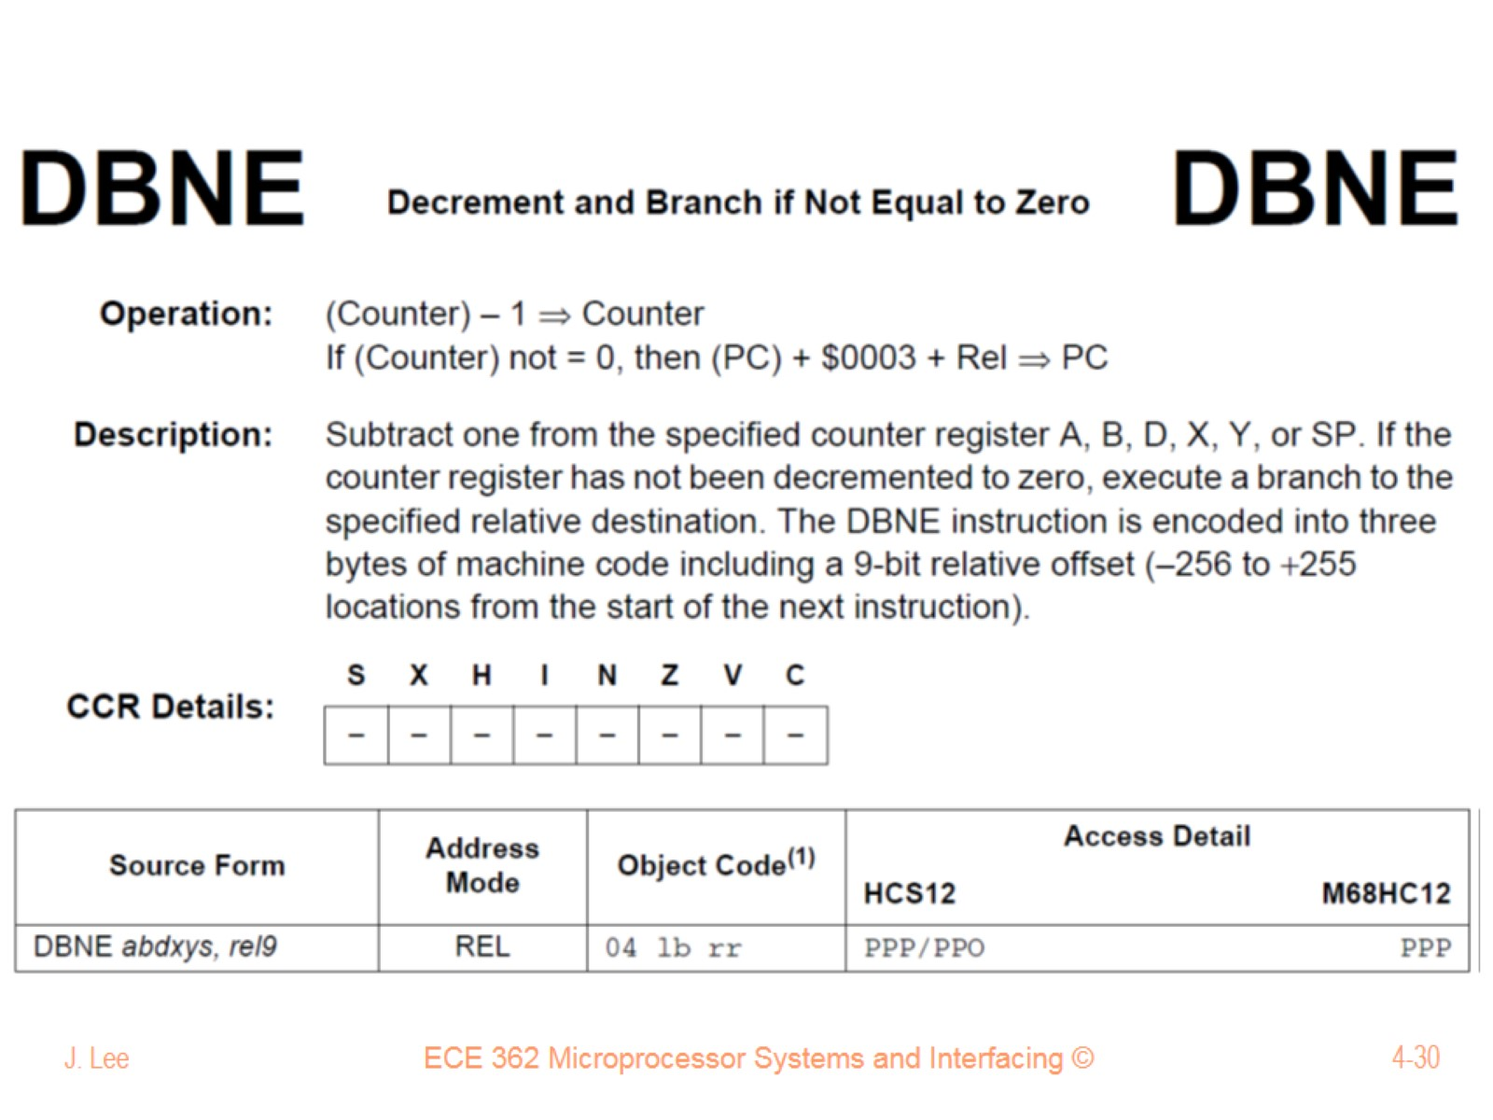

Slide 31
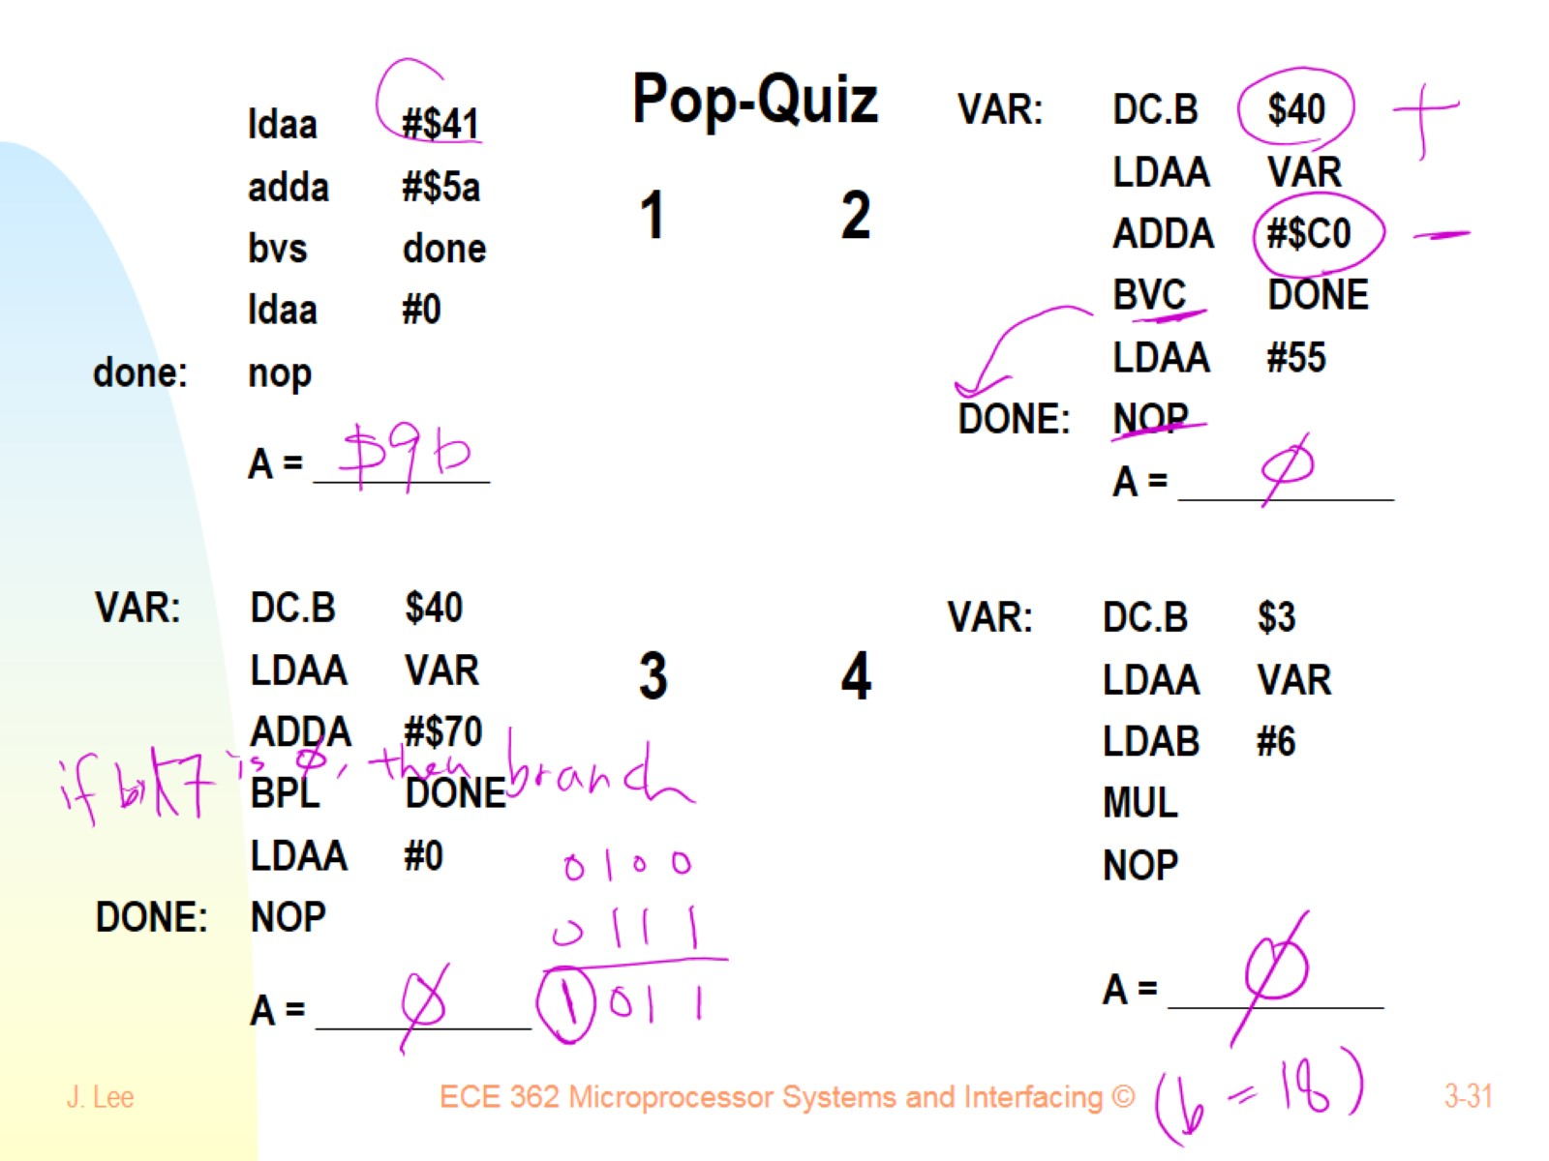
Pop-Quiz 1 2 3 4

